Slide 1
Notes:
Welcome word

Slide 2
Lifting the curse of dimensionality
Notes:
Welcome word

Slide 3
We want to do Bayesian inference
We want to do sampling

Slide 4
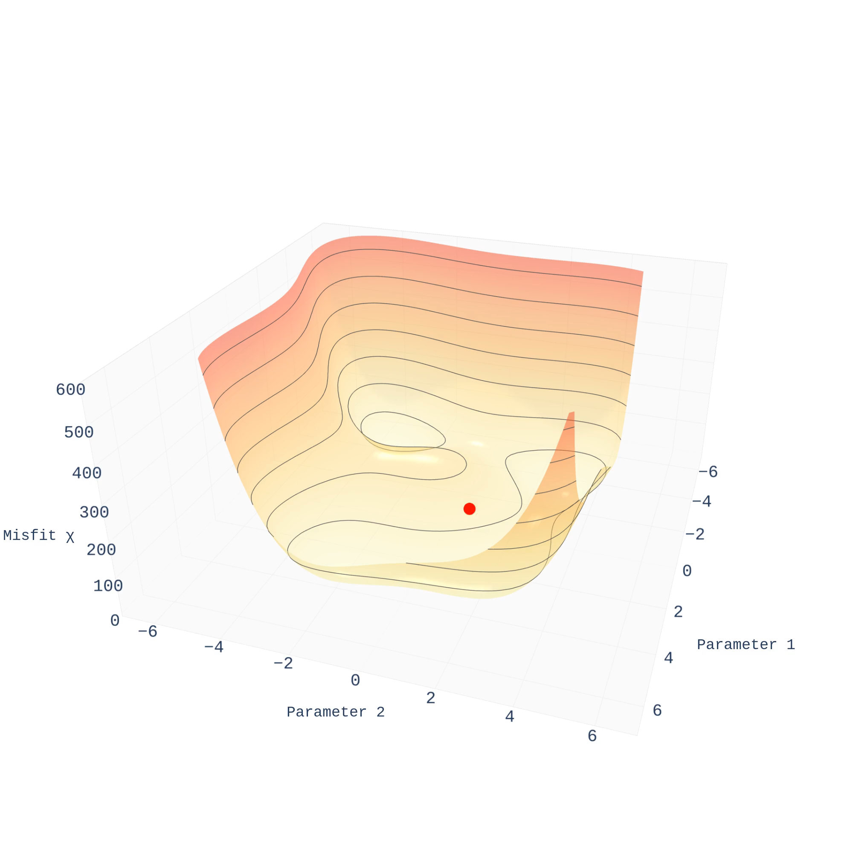
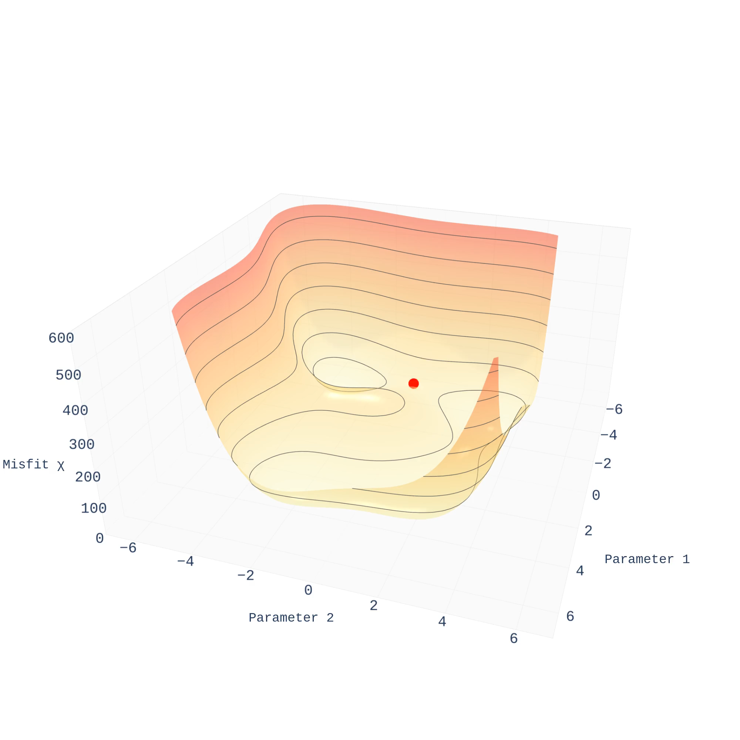
Gradient descent
Good performance
No quantified uncertainty
Metropolis-Hastings
Quantified uncertainty
Bad performance
Notes:
Here, I visualize the end-members of the scenario …

Slide 5
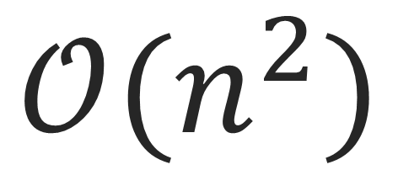
The problem with Metropolis-Hastings
$$𝒪(n^{2})$$
Cost scales quadratically with dimensions
High dimensional MCMC; ‘a bad idea’

Slide 6

MH’s demons
Explorer
Proposes a new direction
Gatekeeper
Has an opinion on this
Notes:
In the 80’s of the last century, some physicists ran into the same problem. But instead of giving up

Slide 7
The curse of dimensionality
m₂
Interesting models: within unit sphere (r=1)
Proposals: within unit cube (side=2)
1
-1
1
m₁
-1

Slide 8
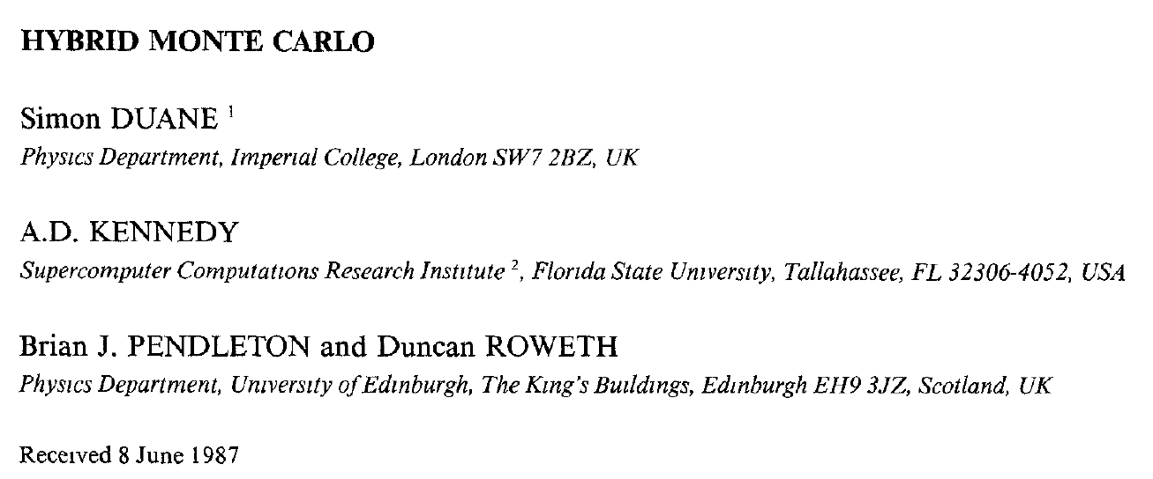
Efficiently sampling with gradients
Hamiltonian Monte Carlo
Notes:
In the 80’s of the last century, some physicists ran into the same problem. But instead of giving up

Slide 9
Revisiting demons
Explorer
Proposes a new direction
Gatekeeper
Has an opinion on this
Notes:
In the 80’s of the last century, some physicists ran into the same problem. But instead of giving up

Slide 10
A third demon
Navigator
Uses a GPS
Explorer
Proposes a new direction
Gatekeeper
Has an opinion on this
Notes:
In the 80’s of the last century, some physicists ran into the same problem. But instead of giving up

Slide 11
The curse of dimensionality
m₂
Interesting models: within unit sphere (r=1)
Proposals: within unit cube (side=2)
1
-1
1
m₁
-1

Slide 12
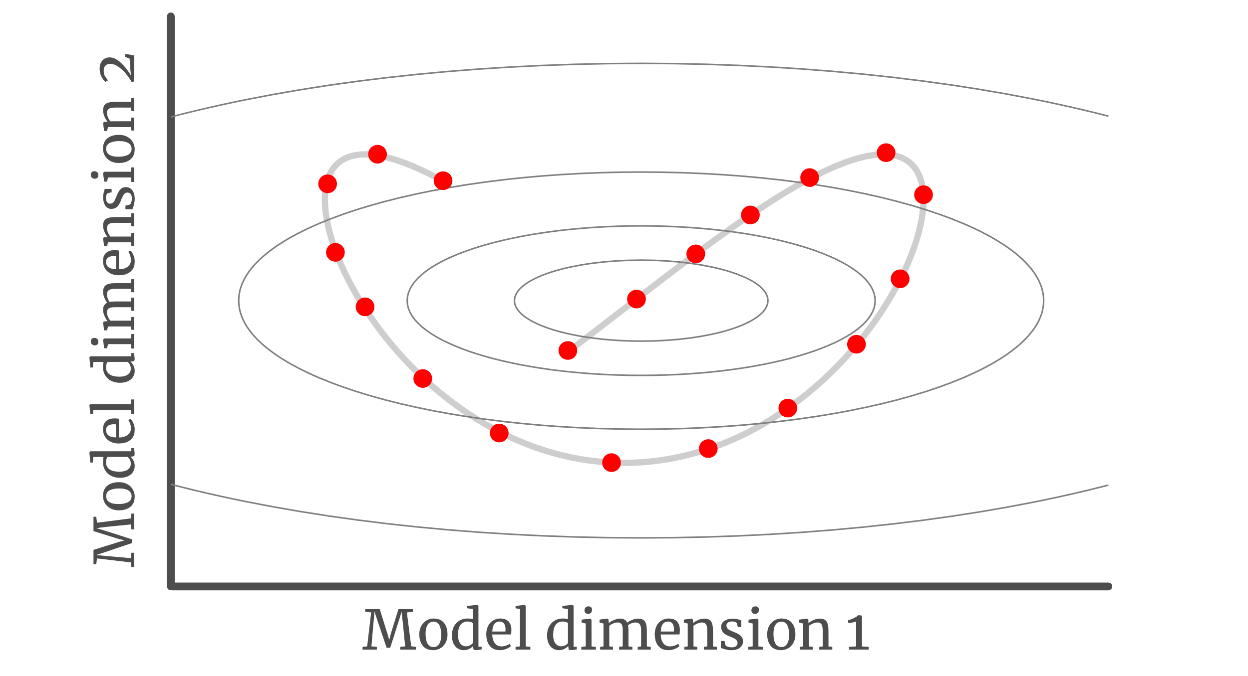
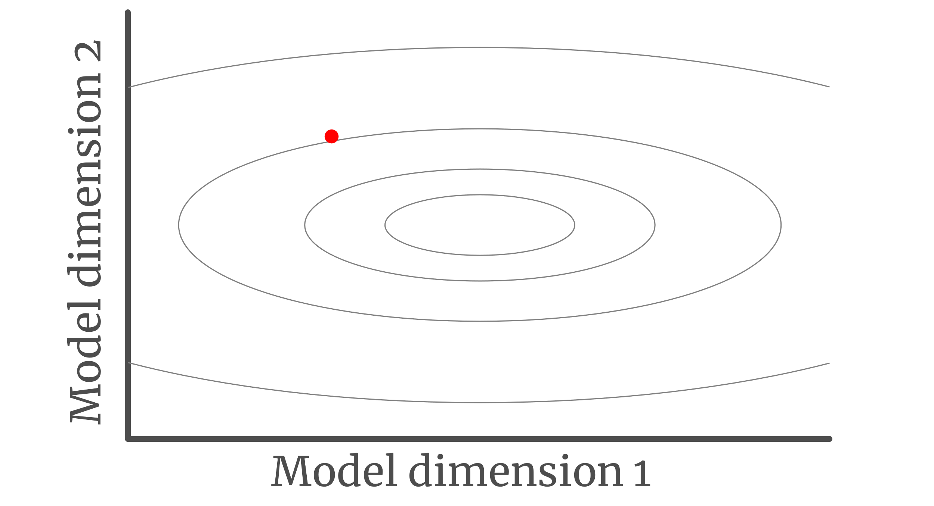
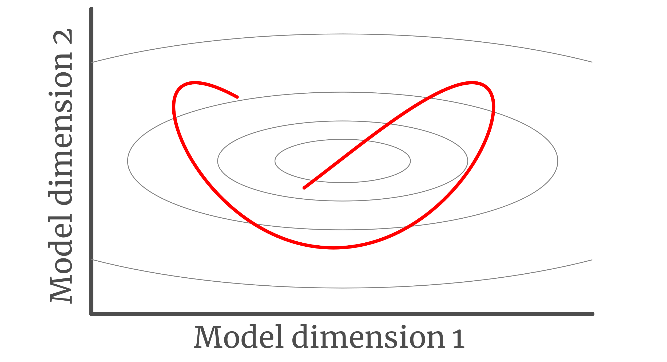
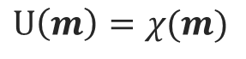
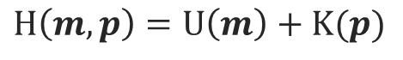
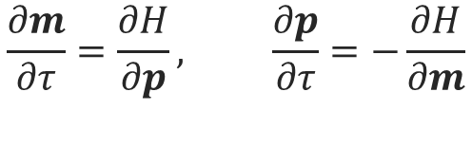
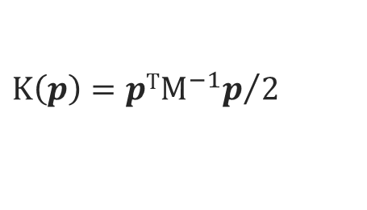
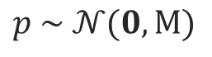
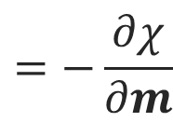
Hamiltonian Monte Carlo
$$U\left(m\right)=χ(m)$$
$$p \sim 𝒩(0,M)$$
$$K\left(p\right)={{pTM}^{−1}p}/2$$
$$H\left(m, p\right)=U\left(m\right)+K(p)$$
$$\frac{∂m}{∂τ}=\frac{∂H}{∂p}, \frac{∂p}{∂τ}=−\frac{∂H}{∂m}$$
$$=−\frac{∂χ}{∂m}$$
Evaluate acceptance
Notes:
The aim of MCMC methods is to generate samples throughout model space. Here I explain briefly one iteration

Slide 13

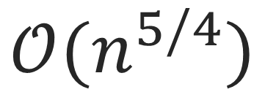
Efficiency from gradients
Quantified uncertainty from sampling
$$𝒪(n^{5/4})$$
Notes:
Looking back on the previously discussed algorithms …

Slide 14
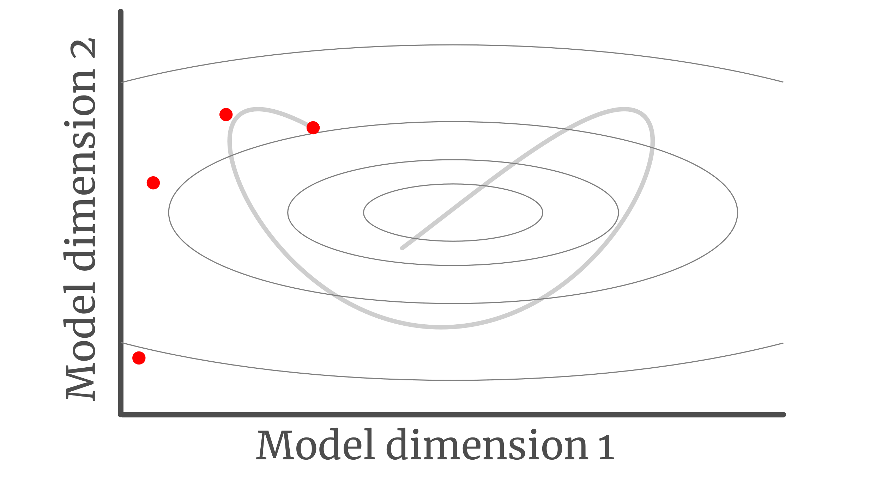
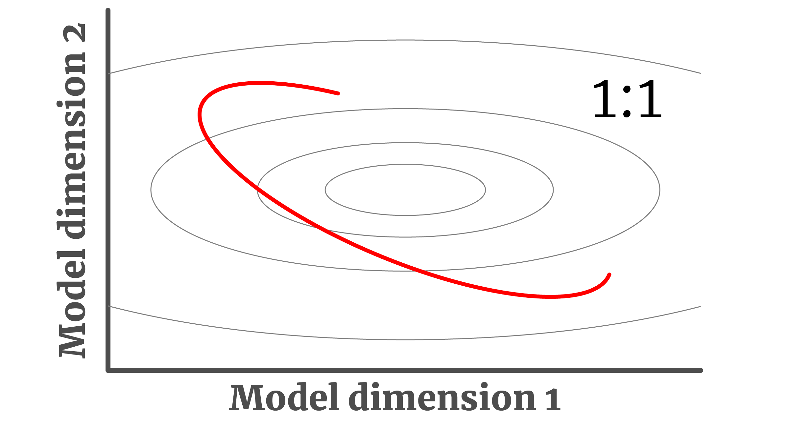
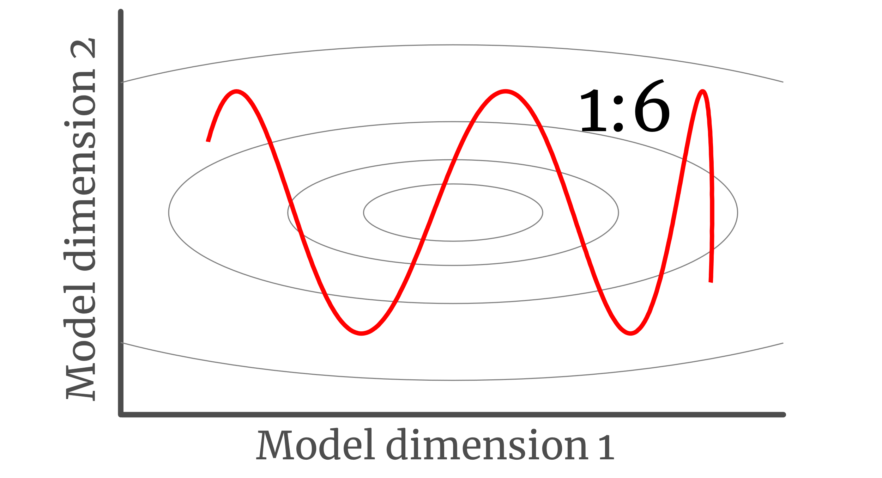
Tuning HMC
GOOD
BAD
Time step
Mass matrix
(n × n)
Notes:
HMC has many settings

Slide 15
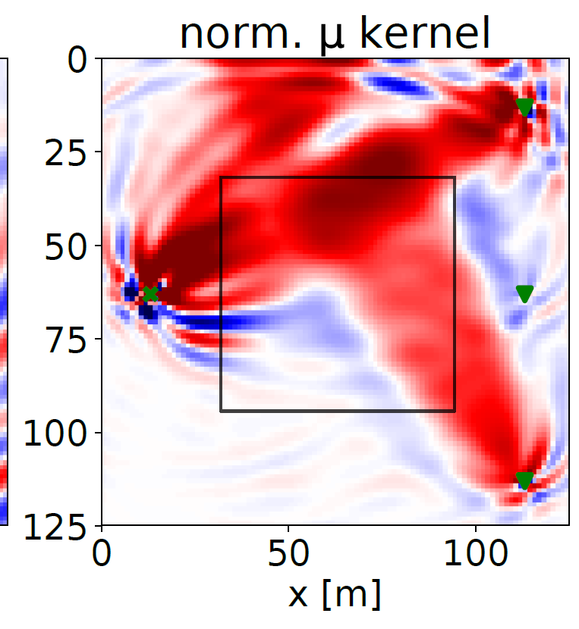
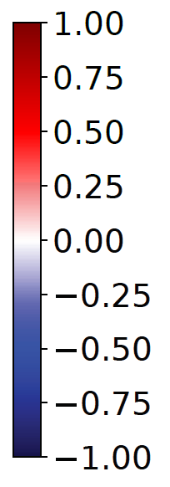
HMC and cheap gradients: a good duo
Inverse problem provides gradients
(e.g. analytical, adjoints, autograd)
HMC needs gradients
y[m]
Notes:
The real reason why this research started …

Slide 16
HMC in management terms
Performance
HMC
General Purpose
Algorithm: no or few
constraints from the
problem
Average
Type of Problem
Many seismological problems
Especially high-dimensional
Notes:
The real reason why this research started …

Slide 17
Notebooks

Slide 18
Following now are extra slides
Feel free to shoot me questions on
lars [DOT] gebraad [AT] erdw [DOT] ethz [DOT] ch

Slide 19
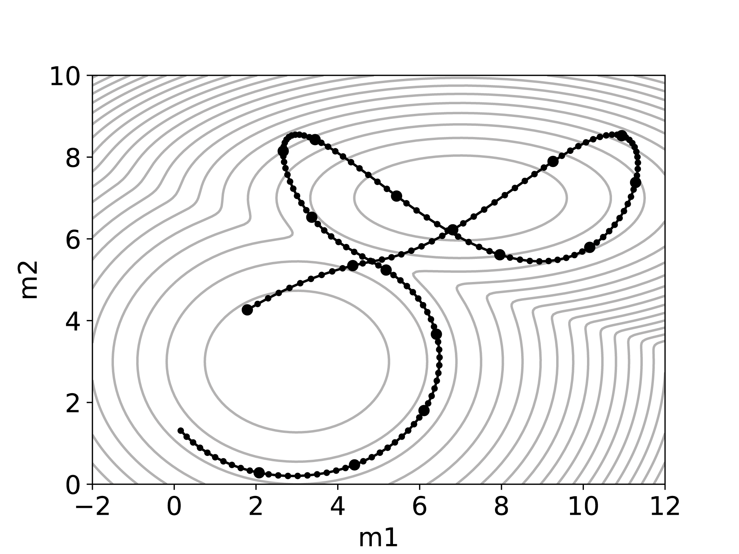
Tuning parameters are locally optimal
A trajectory of an HMC particle on a non-Gaussian 2D target

Slide 20
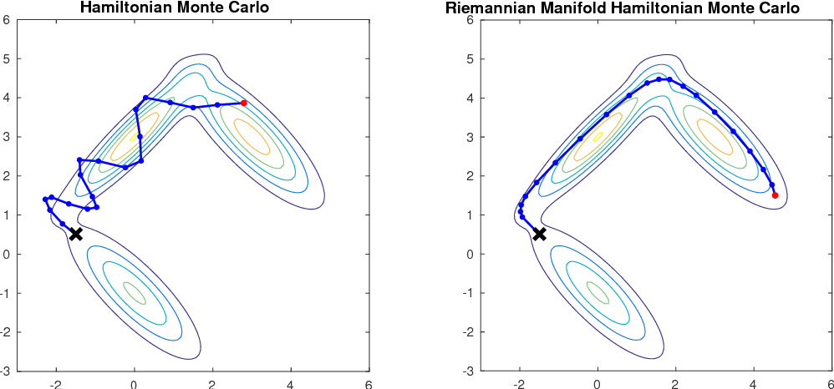
Variations on the theme
Notes:
The real reason why this research started …

Slide 21
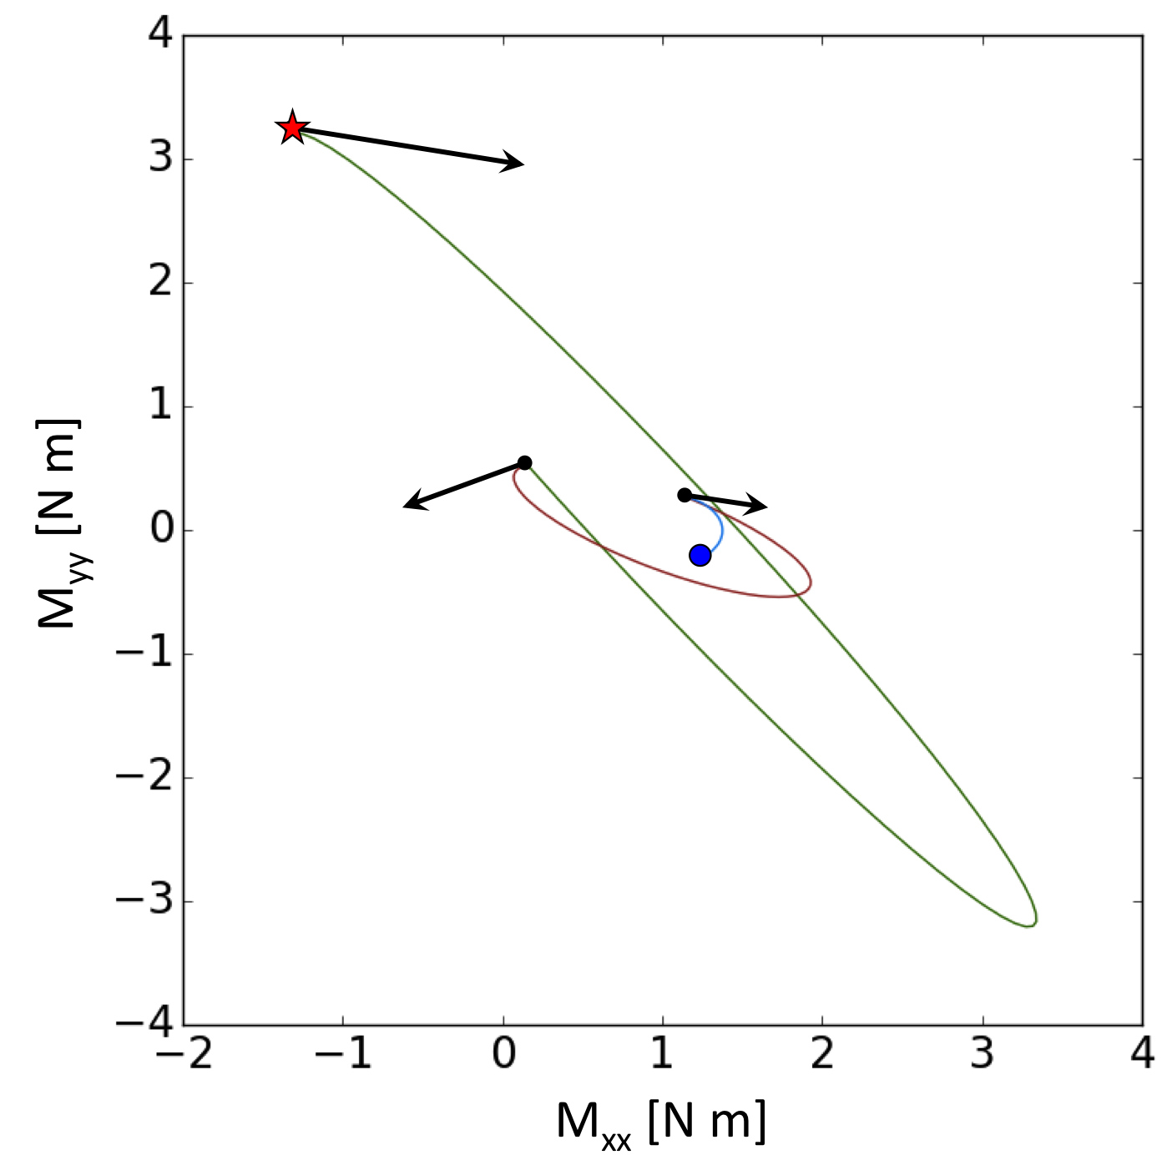


Hamiltonian Monte Carlo
Initial model m, chosen randomly.
Misfit U(m) defines potential energy.
Random momentum p [auxiliary quantity].
Defines kinetic energy K(p).
Solve Hamilton’s equations with Hamiltonian
H(m,p) = U(m) + K(p) .
Move towards a new test model, m_{test}.
Evaluate Metropolis rule:
If rejected: go back.
If accepted: move on.
initial model
chosen randomly
p
best model
m₁
m_{test}
p
m₂

